Slide 1
Introduction to Differential Analysis of Fluid Motion
By
Dr. S. S. Baral

Slide 2
Outline
Conservation of mass
Stream function for two-dimensional incompressible flow
Motion of a fluid particle (Kinematics)
Momentum equation
Introduction to CFD

Slide 3
Conservation of mass
Objective
To obtain differential equation for conservation of mass in rectangular and in cylindrical coordinates
Approach
Applying conservation of mass (basic law) to differential control volume

Slide 4
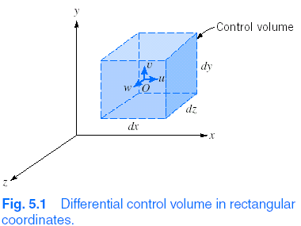
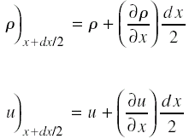

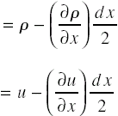
Conservation of mass – Rectangular coordinate system
Taylor series expansion
about point ‘O’ (for density
and velocity)

Slide 5

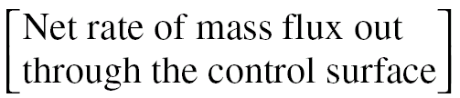
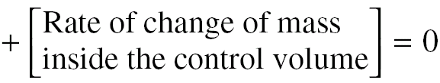
Conservation of mass – Rectangular coordinate system
Conservation of mass in integral form (Basic law for a system)

Slide 6
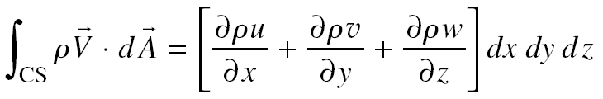


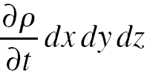
Conservation of mass – Rectangular coordinate system
Using basic law in integral form and expressions for density and velocity for different surfaces of a control volume

Slide 7
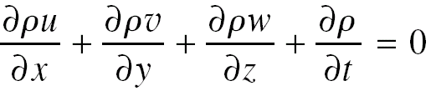
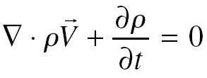
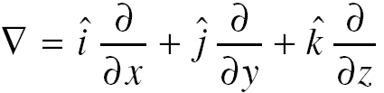
Conservation of mass – Rectangular coordinate system
Conservation of mass – Differential equation
→ “Continuity Equation”
In vector form
Where

Slide 8
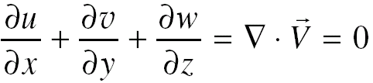
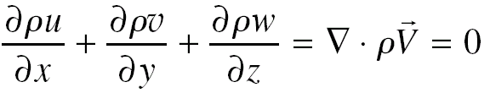
Conservation of mass – Rectangular coordinate system
Special cases
Incompressbile fluid
Steady compressible flow

Slide 9
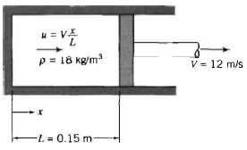
Example 1
A gas filled pneumatic strut in an automobile suspension system behaves like a piston cylinder apparatus. At one instant when the position is L= 0.15 m away from the closed end of the cylinder, the gas density is uniform at ρ= 18 kg/m³ and the piston begins to move away from the close end at 12 m/s. Assume that a simple model that the gas velocity is one dimensional and proportional to distance from the closed end; it varies linearly from zero at the end to u= V at the piston. Find the rate of change of gas density at this instant. Obtain an expression for the average density as a function of time.

Slide 10
Example-2
Which of the following equations is/are represents possible two-dimentional incompressible flow
u= 2x²+y²-x²y; v=x³+x(y²-2y)
u= (x+2y)xt; v= -(2x+y)yt

Slide 11
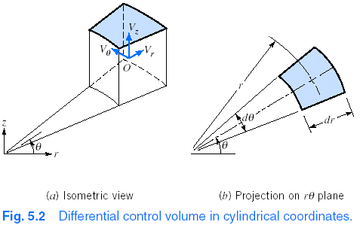
Conservation of mass – Cylindrical coordinate system
Differential control volume
Velocity components – V_{r,} V_{θ} and V_{z}

Slide 12
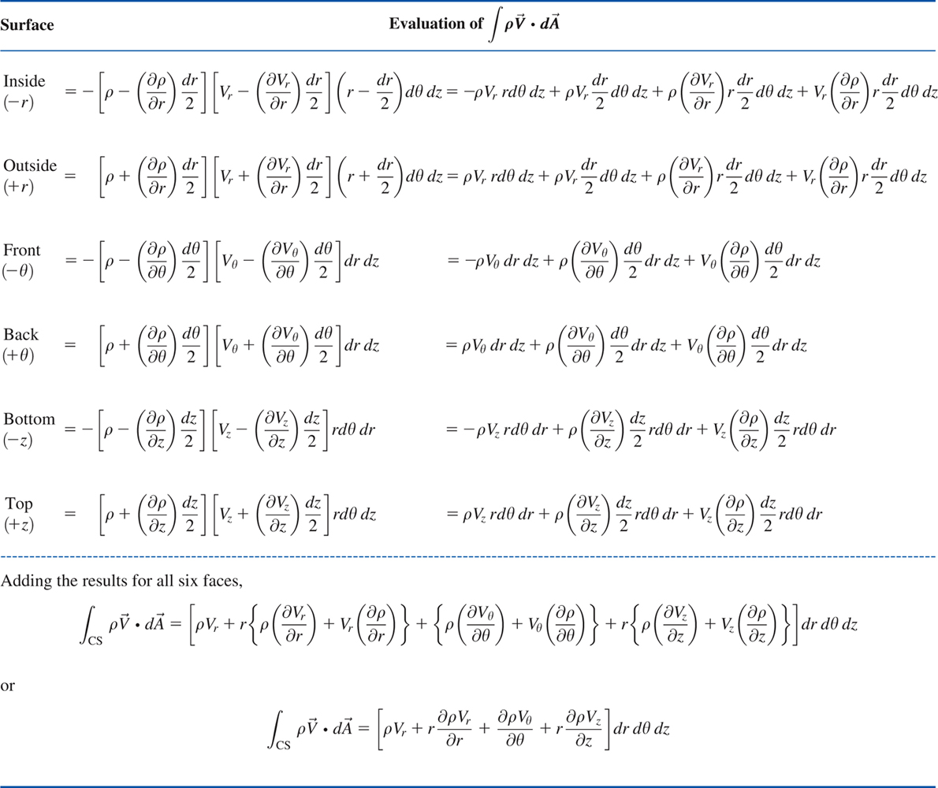
Conservation of mass – Cylindrical coordinate system

Slide 13
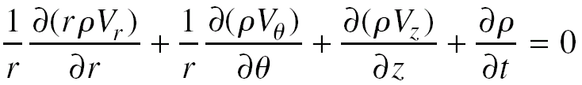
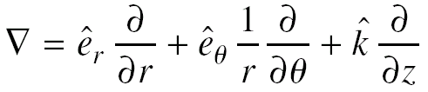
Conservation of mass – Cylindrical coordinate system
Differential equation (Governing equation)
→ Continuity equation
In vector form
Where

Slide 14
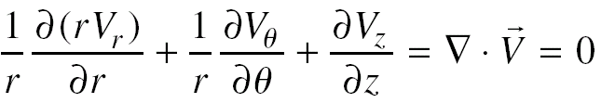
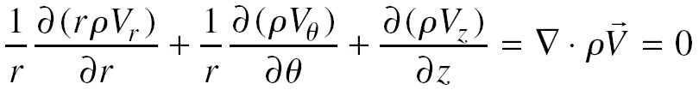
Conservation of mass – Cylindrical coordinate system
Special cases
Incompressbile fluid
Steady compressible flow

Slide 15
Example-3
Whether the following equation is represents possible incompressible flow
V_{r}=Ucosθ[1-(a/r)²]; V_{θ}=-Usinθ[1+(a/r)²]

Slide 16
Stream function for 2-D incompressible flow
Streamline
Lines tangent to velocity vectors in a flow at an instant
It is generally defined in terms of stream function
Stream function (ψ)
Represents velocity components of a 2-D incompressible flow with a single function

Slide 17
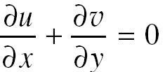
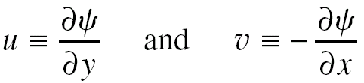
Stream function for 2-D incompressible flow
Continuity equation for 2-D incompressible flow (rectangular coordinates)
Stream function
Defined in such a way that it satisfies the continuity equation

Slide 18
Stream function for 2-D incompressible flow
Stream function / Streamline
Stream function is constant along a streamline at any particular instant of time.
Ψ = 1, 2, 3, etc. → Represents different streamlines
What is the physical significance of stream-function (constant values)?

Slide 19
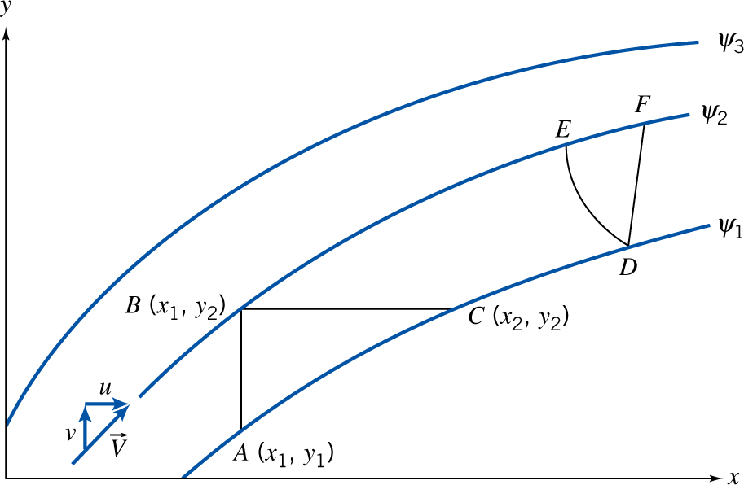
Stream function for 2-D incompressible flow
Consider instantaneous streamlines in a 2-D flow
Volume flow rate between two streamlines is given by the difference between two stream function values.

Slide 20
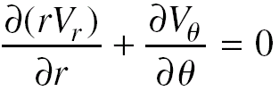
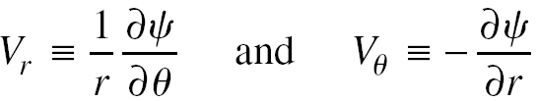
Stream function for 2-D incompressible flow
Cylindrical coordinates (rθ – plane)
Continuity equation
Stream function

Slide 21
Example-4
Determine the family of stream function ψ that will yield te velocity field V=y(2x+1)i+[x(x+1)-y²]j

Slide 22
Example-5
Consider a flow with velocity components u=0, v=y(y²-3z²) and w= z(z²-3y²).
Is this a one, two or 3D flow?
Demonstrate whether this is incompressible flow.
Derive stream function for this flow

Slide 23
Motion of a fluid particle (Fluid kinematics)
Fluid translation
Particles accelerates from one point to another
Fluid rotation
Particle rotates about an axis
Fluid deformation
Linear deformation
Particles’ sides stretch/contract)
Angular deformation
Angles between sides of a particle changes

Slide 24
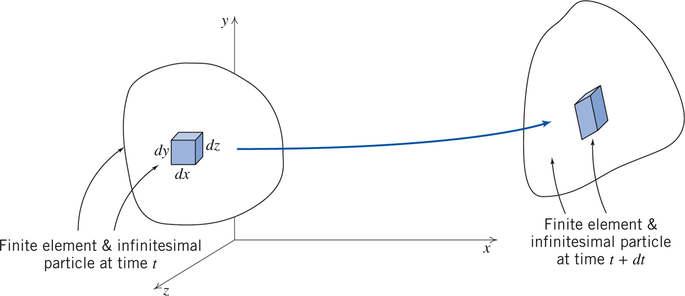
Motion of a fluid particle (Fluid kinematics)

Slide 25
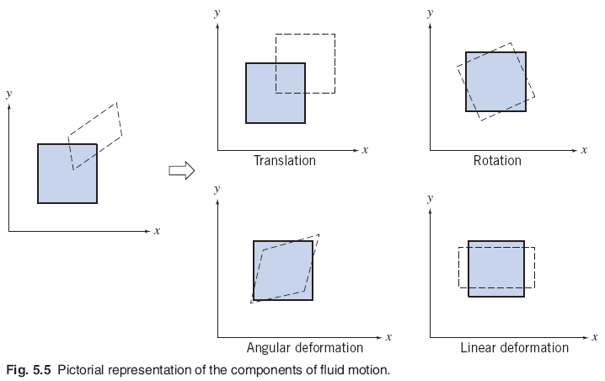
Motion of a fluid particle (Fluid kinematics)

Slide 26
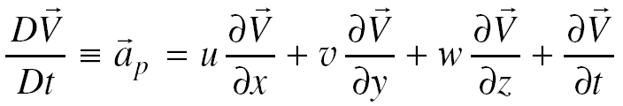
Fluid translation
Relation between acceleration of a fluid particle to the velocity field
→ Substantial derivative / material derivative / particle derivative

Slide 27

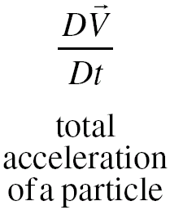
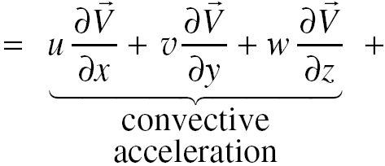
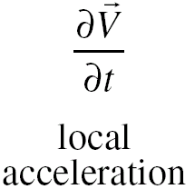
Acceleration of a fluid particle – Physical significance
Special cases
Two dimensional flow
One dimensional flow
Steady flow

Slide 28
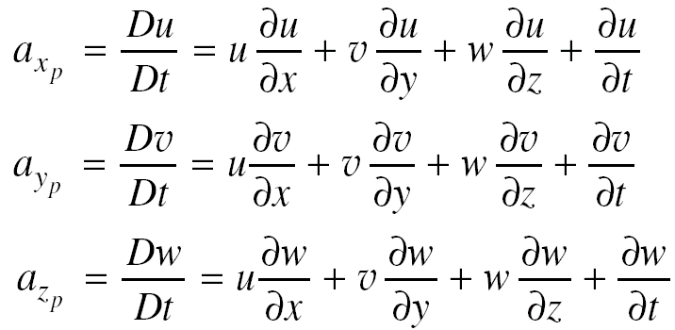
Acceleration of a fluid particle - components
Components of acceleration in rectangular coordinates

Slide 29
Eulerian vs Lagrangian approach
Eulerian approach
Method of description/approach that focuses on properties of a flow at a given point at any instant of time
Useful for computing the acceleration of a fluid particle anywhere in a flow from the velocity field
Lagrangian approach
Method of description/approach that follows particle
Acceleration, position and velocity of a particle are specified as a function of time.

Slide 30
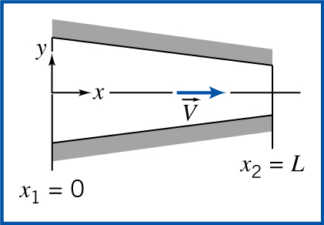
Example – Particle acceleration in Eulerian and Lagrangian descriptions
2-D, steady, incompressible
flow through nozzle
V = V₁(1+ x/L) on x- axis
Determine
Acceleration of a particle along centerline using Eulerian approach
Acceleration of a particle along centerline using Lagrangian approach
Acceleration at x = 0 and x = L

Slide 31

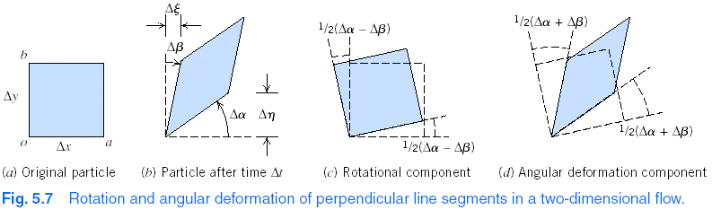
Fluid rotation
Particle rotation
Determining rotation components

Slide 32
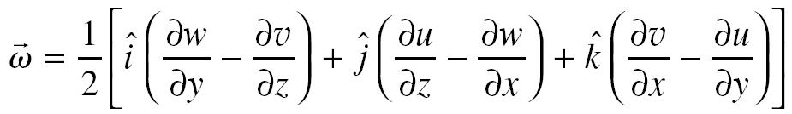

Fluid rotation
Fluid rotation in terms of velocity components
Vortex flow
Flow consisting of circular streamlines

Slide 33

Fluid rotation
Important facts
Particles begin to rotate if they experience a torque caused by surface shear stresses.
Particle body forces and normal (pressure) forces may accelerate or deform particle, but cannot generate torque
Rotation of fluid particles will always occur for flows in which we have shear stresses (Viscous fluid flows)
Irrotational flows
Flows for which no particle rotation occurs.
Vorticity ( )
Measure of rotation of a fluid element

Slide 34
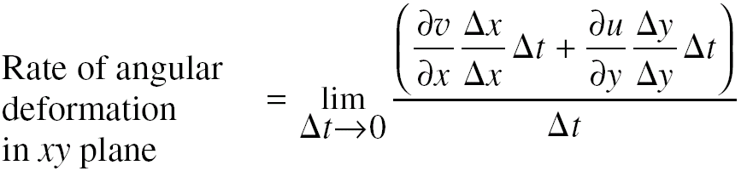
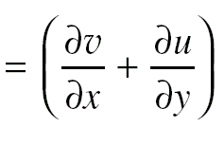
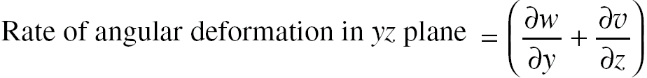
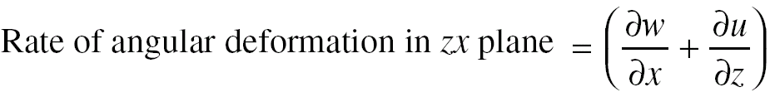
Angular deformation
Deformation in the xy plane (Δα + Δβ)

Slide 35
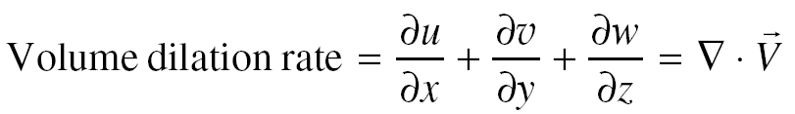
Linear deformation
Volume dilation rate
Rate of change of volume per unit volume

Slide 36
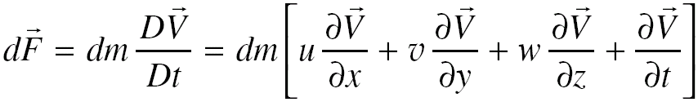
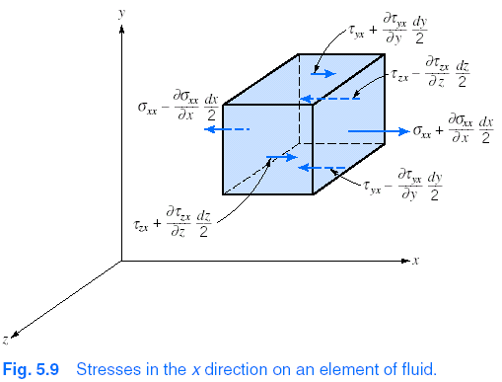
Momentum equation
Newton’s second law
Forces acting on a
fluid particle
Using Taylor series

Slide 37
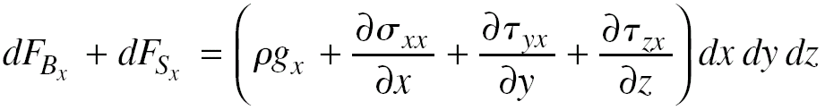
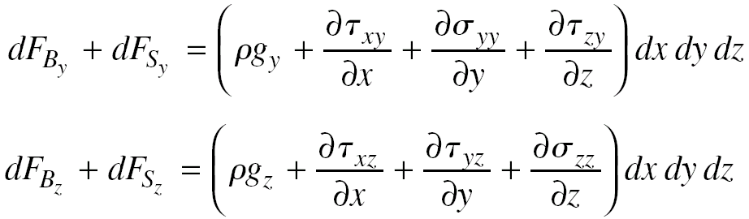
Momentum equation
Forces on a fluid particle (after simplification)

Slide 38
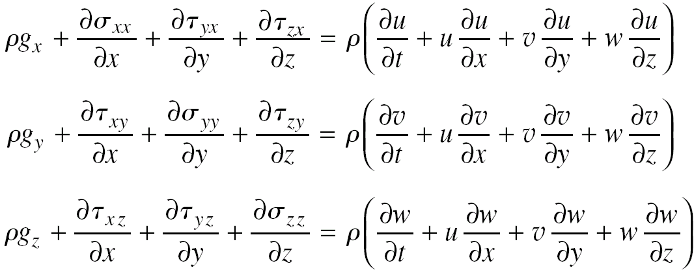
Momentum equation
Differential momentum equation
Generalized form of momentum equation

Slide 39
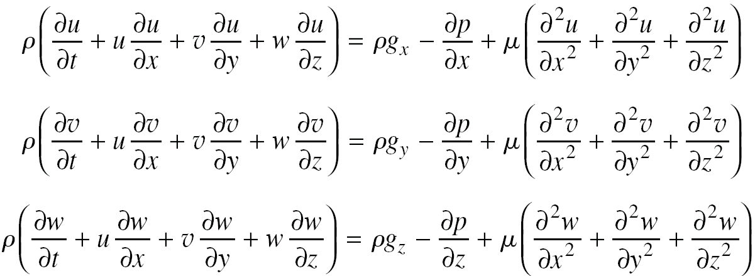
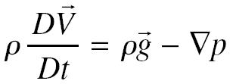
Momentum equation
Navier-Stokes equations
Newtonian and incompressible fluid
Most famous set of equations in fluid mechanics
Special case : Euler’s equation

Slide 40
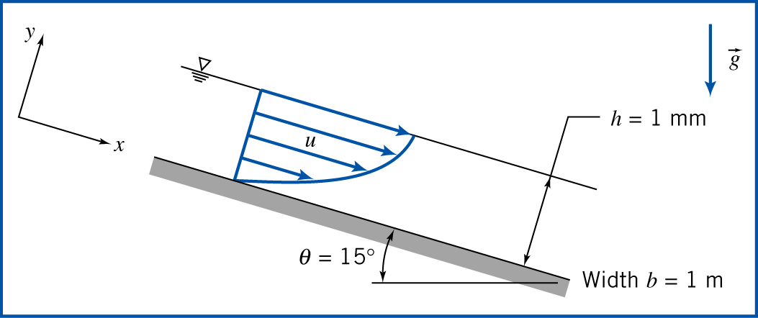
Example 6
A liquid flows down an inclined plane surface in a steady, fully developed laminar film of thickness h. simplify the continuity and Navier-Stokes equation to model this flow field. Obtain expressions for the liquid velocity profile, the shear stress distribution, the volume flow rate and average velocity. Relate the liquid film thickness to the volume flow rate per unit depth of surface normal to the flow. Calculate the volume flow rate in a film of water h=1 mm thick flowing on a surface b= 1m wide, inclined at θ= 15⁰ to the horizontal.

Slide 41
Example-7
A viscous liquid fills the annular gap between vertical concentric cylinders. The inner cylinder is stationary, and the outer cylinder rotates at constant speed. The flow is laminar. Simplify the continuity, Navier-Stokes, and tangential shear stress equations to model this flow field. Obtain expressions for the liquid velocity profile and the shear stress distribution. Compare the shear stress at the surface of the inner cylinder with that computed from a planar approximation obtained by "unwrapping" the annulus into a plane and assuming a linear velocity profile across the gap. Determine the ratio of cylinder radii for which the planar approximation predicts the correct shear stress at the surface of the inner cylinder within 1 percent.

Slide 42
Quiz-3
The y component of velocity in steady, incompressible flow field in the xy plane is v=-Bxy^{3,} where B= 0.2 m⁻³.s, and x and y are measured in meters. Find the simplest x component of velocity for this flow field. Find the equation of the streamlines for this flow at (1,4) and (2, 4).

